Slide 1
Data Science Project
By: Ky-Long (Ky) Nguyen

Slide 2
Table of Contents
Problem Statement
Methodology
Findings/Insights
Recommendations
Future Work Proposal
**I may have slid a few jokes here and there but I promise I’m being serious with my presentation. Please don’t fail me.**

Slide 3

You all just got Rickrolled.
Now back to our regularly scheduled presentation.

Slide 4
Prologue
Data science is a specialized field within computers and information systems that has applications in virtually all sectors of industries regardless of business level. In a world that’s technologically evolving faster than our own ability to keep up or adapt, there’s a need to keep all potential career positions of data science filled regardless of application and concentration. Otherwise, we’d be vulnerable against cyberattacks or be given subpar information that could create potentially catastrophic results if incorrectly executed.
Original Dataset: https://www.kaggle.com/datasets/saurabhshahane/data-science-jobs-salaries

Slide 5
Problem Statement: 1 Problem (Not 99 problems)
Q: “Why are you working on this project?”
A: Well, not only because I’m obligated to do so to pass this course but also because the visualization of the data can illustrate the historical trend of the pay of data scientists across the spectrum of various industries. This is because data scientists will almost always be in high demand especially in this technological age. Additionally, it can provide inferences regarding the employment condition of the data science career in relation to salary across the passage of time.
Q: “Well… what’s the main problem here?”
A: The goal of this analysis is to provide a more thorough understanding and comparison of data scientists with respect to appropriate independent variables

Slide 6
Problem Statement: Benefits
I get to pass the class
A historical illustration of salaries in a career sector that will likely be in high demand indefinitely
Encourage potential incentives to boost morale and motivation which in turn reduces turnover rate
Have documented data regarding the annual income for data scientists before taxes, expenses, and our dogs (I’m looking at you Winnie)
Provide statistical information regarding the desired concentration of data science with respect to necessary credentials, personal skills, and financial situation

Slide 7
Methodology
Q: “How did you break the problem down?”
A: I chose to break it down by experience level, employment level, and the specific job titles. Additionally, I isolated geographical restrictions such as modality, country of employment, and currency difference depending on country. Also, the size of a company can play a factor so I made it an independent variable. Also, I created an Excel version of the original CSV so that I can independently visualize and analyze the data without compromising the original data.

Slide 8
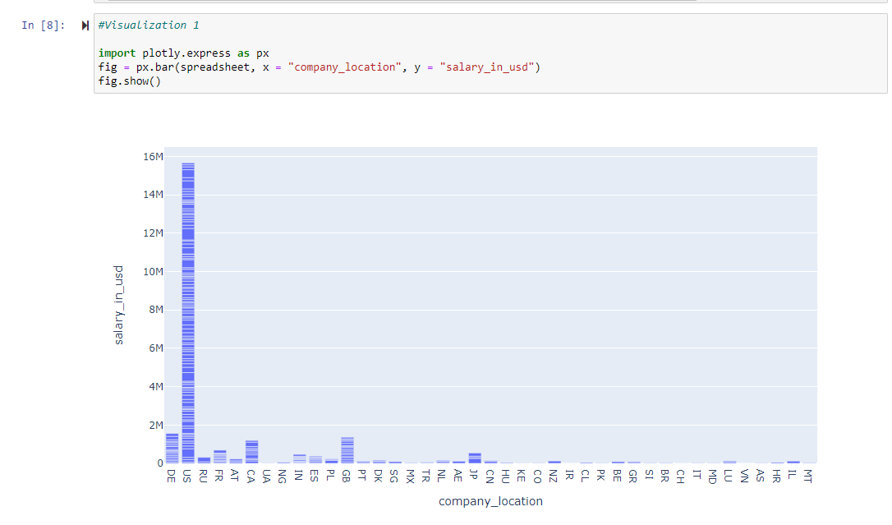
Salaries are highest when employment is restricted to the US and territories

Slide 9
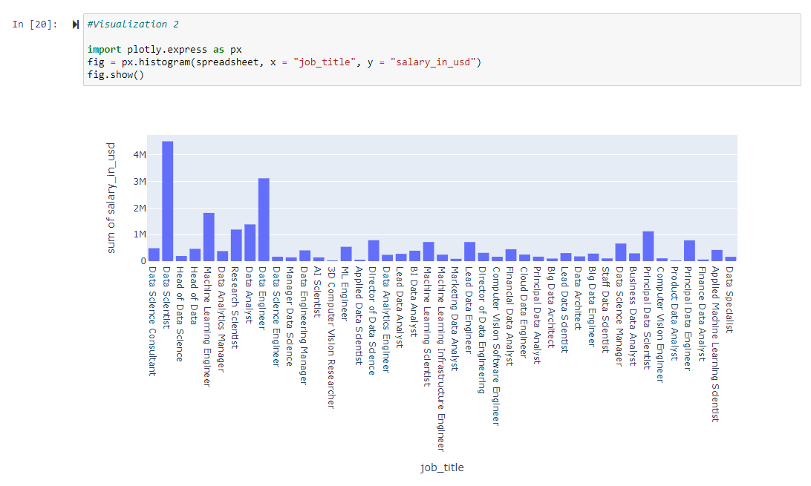
Despite the extensive skill range, a basic data scientist makes the most

Slide 10
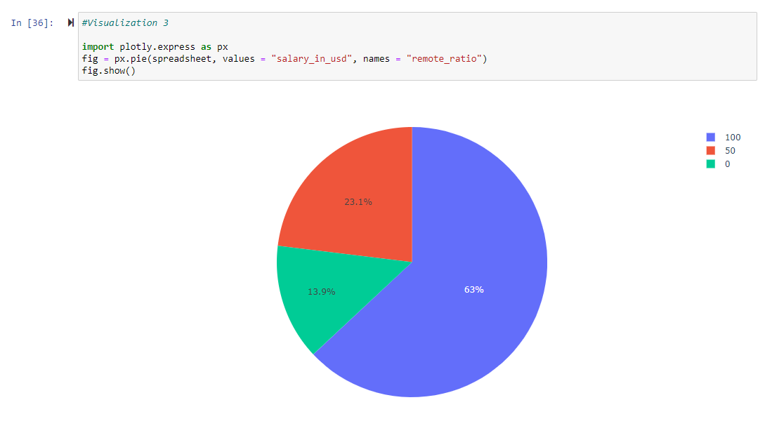
Given modality ratios, fully remote employment makes the highest salaries possible

Slide 11
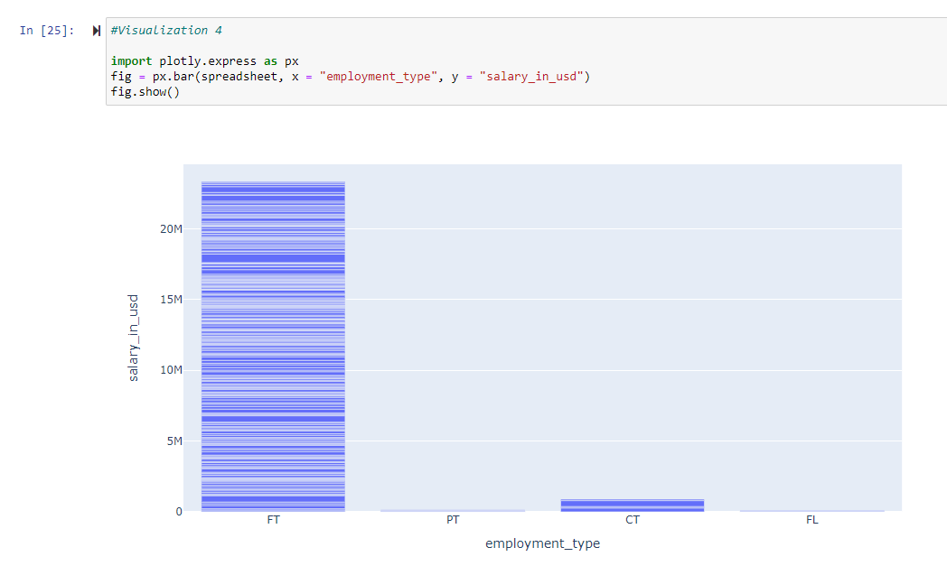
Full time employment accounts for 96% of potential salaries

Slide 12
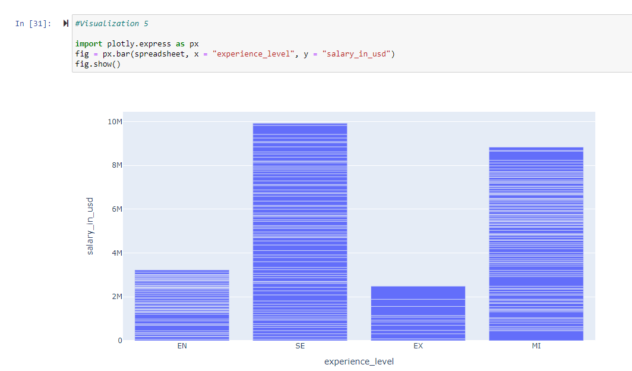
Despite the inferior skillset, entry-level/mid-level experience outperforms executive-level work

Slide 13
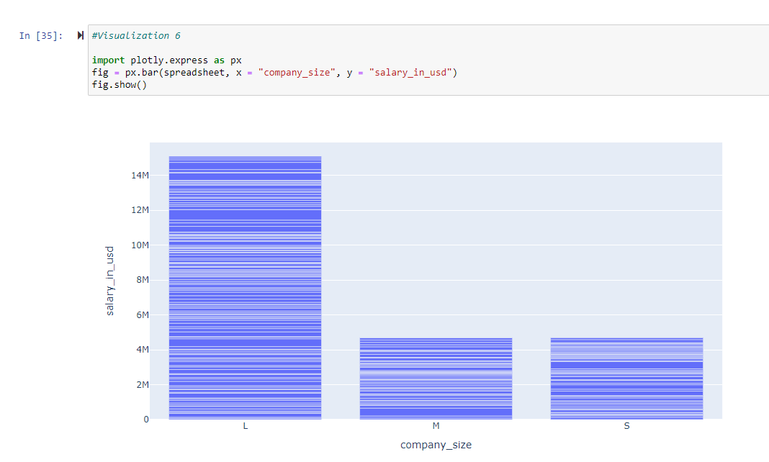
Large companies nearly make triple the potential salaries compared to its competitors

Slide 14
Recommendations
With respect to geography and logistics, an important metric is to find a flexible balance between desired salary range and geographical residence because the economic benefits are not a significant dealbreaker
While a basic data scientist makes the highest salary, it’s still important to branch out and broaden your skill set because in doing so, you increase your odds of employment and salaries can compound on top of each other
Especially since COVID-19’s first act of chaos in 2020, people have been struggling and debating between primary working modalities. With respect to current conditions, it should be reasonable to work remotely if physical attendance cannot be conducted because salary differences are negligible and in most cases, salaries are higher in remote working conditions
Full time employment should be sought out due to the 96% salary composition
Given industry demand for all data scientists, one can easily make similar/identical income compared to senior-level work so allow for a balance between background education and motivation for employment since salary differences are competitively excellent thus allowing for healthy employment competition

Slide 15
Future Work Proposal
Work a 9-5 job
Buy a house
Eat so much candy that your dentist starts crying
Praise the god who created Stack Overflow
Invest in stocks
Expect the Spanish Inquisition with Monty Python
Worship Winnie
Or else
Just kidding. Now back to our regularly scheduled presentation.

Slide 16
Future Work Proposal (Seriously.)
The next step is to plan a roadmap regarding my future in data science given my analysis and all statistics gathered during this project
Given the evolution of technology and data, the problem will almost inevitably be revisited but the frequency of reanalysis will vary
The project can be improved accordingly with more sources of data as well as more chronological records to accommodate for more passage of time

Slide 17
Thank You!
Questions? Ask Winnie not Google (While Prof. Weinstein teaches us every Thursday, Winnie is probably participating in a pyramid scheme)
I promise I was being serious during the presentation. I wanted to have a little fun with it
More questions? Ask Stack Overflow.

